Slide 1
虚拟与现实之间
SPATIO-TEMPORAL ANALYSIS OF URBAN ECONOMIC RESILIENCE DURING COVID-19 WITH MULTILAYER COMPLEX NETWORKS

Slide 2
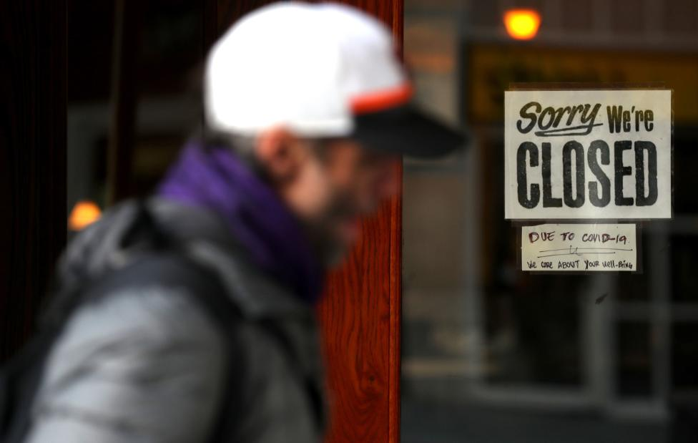
Background
Methods
Results
Conclusion
Future work
The impact of COVID-19
The COVID-19 pandemic has significantly impacted global economic growth.
Industries, especially the gastronomy business, faced operational difficulties.
The closure of many restaurants tested the resilience of urban economies.
By 2022, the annual growth rate of global restaurant patrons sat at a mere 0.81%

Slide 3
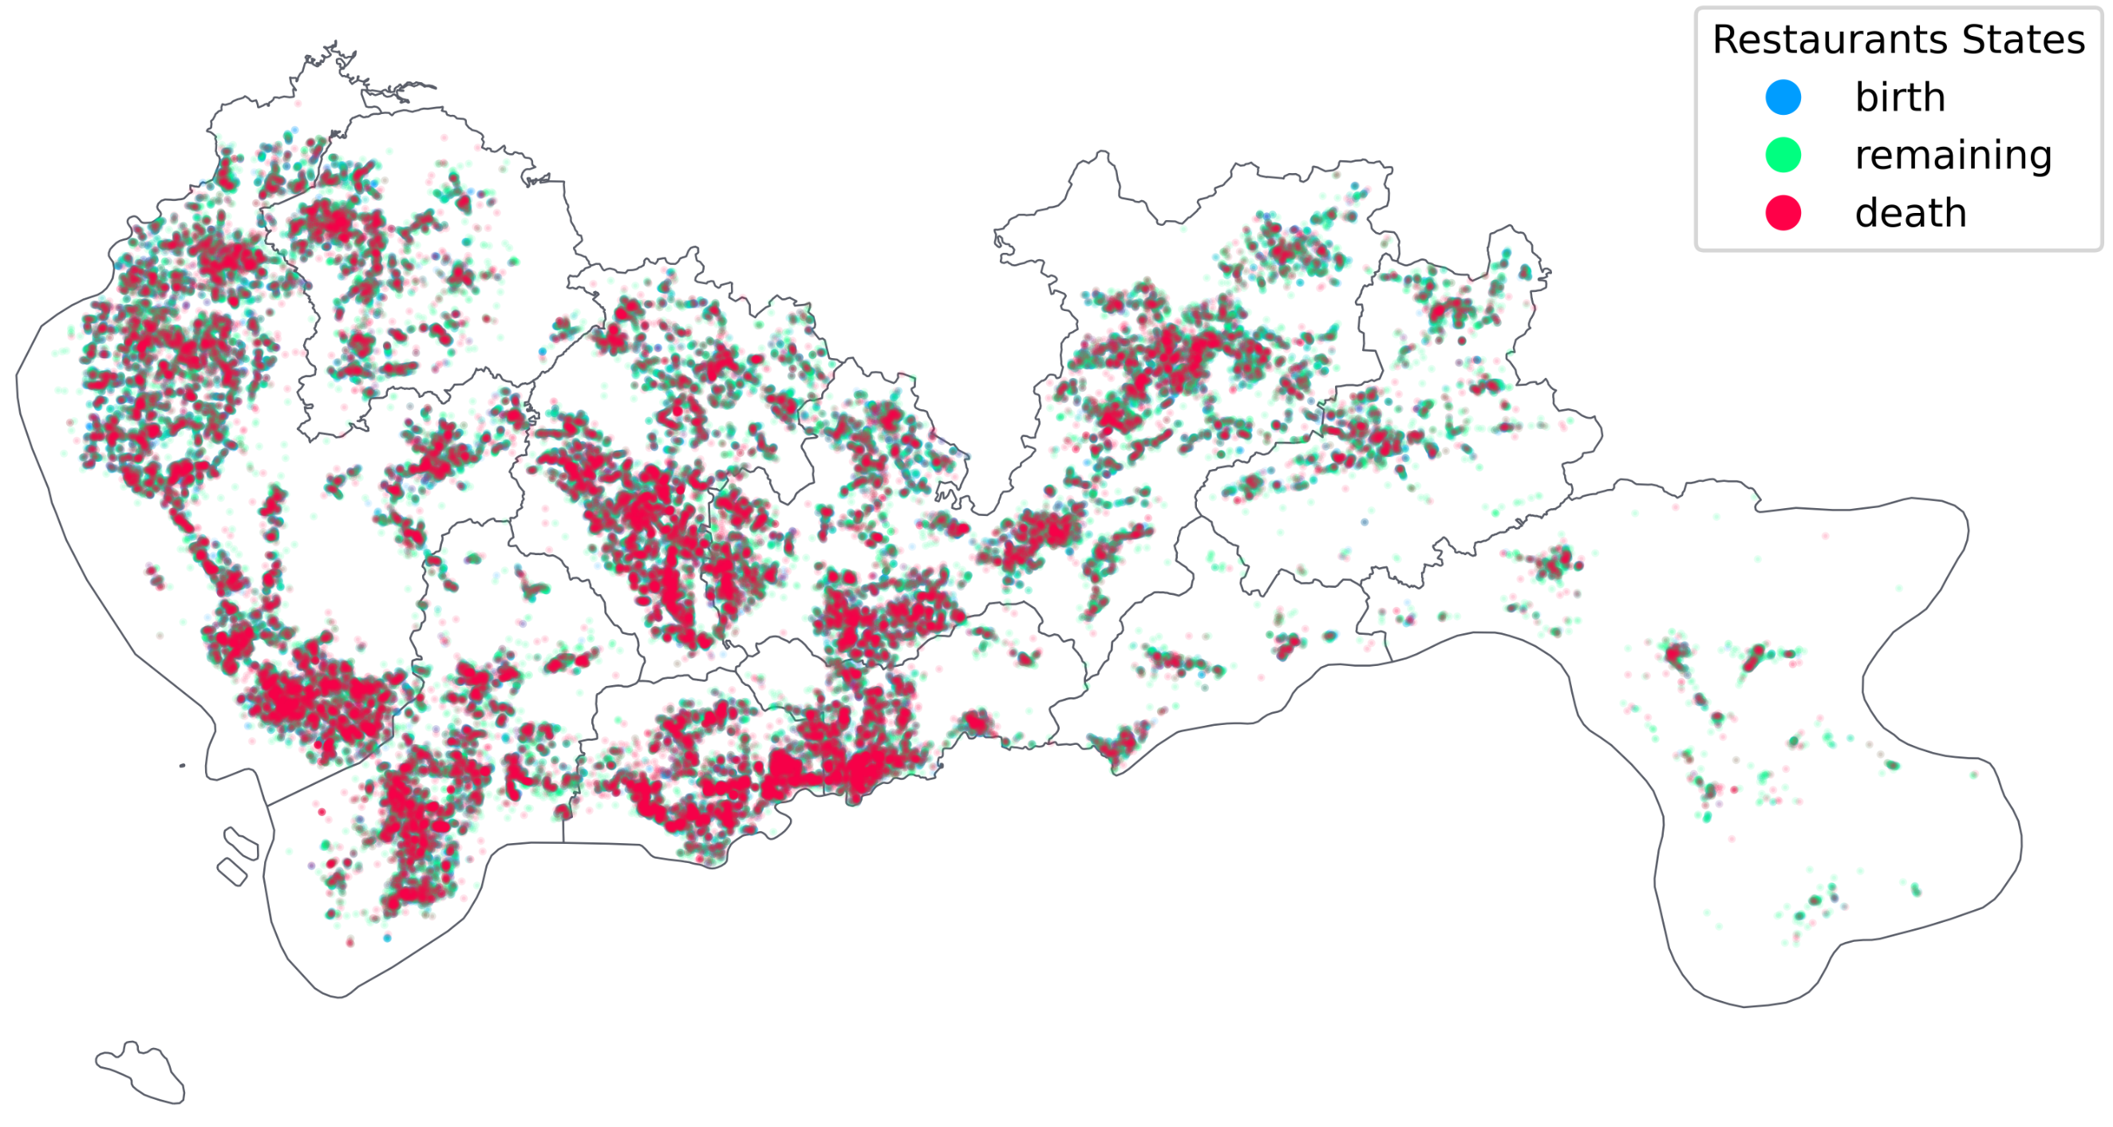
Background
Methods
Results
Conclusion
Future work
Indicators of economic resilience
The gastronomy business is decentralized and location-based.
It is closely related to the economic attributes of cities.
The success or failure of restaurants can indicate urban economic health.
Figure: Spatial Distribution of Closed Restaurants in Shenzhen, China, 2020
Prior research shows restaurants accurately predict urban socio-economic attributes with 90%-95% accuracy (Dong et al., 2019).

Slide 4
Background
Methods
Results
Conclusion
Future work
Research gap
High-Resolution Mobility Data: Many studies have utilized high-resolution mobility data to examine the impact of COVID-19 and related interventions on urban movement.
Microscopic Research Gap: There's limited research on the microscopic effects of human mobility on urban economies during the pandemic.
Critically, only a handful of studies explore the resilience of urban economies in the face of pandemic shocks and the effectiveness of intervention policies
The concept of urban resilience pertains to a city’s ability to recover and adapt when confronting adversity

Slide 5
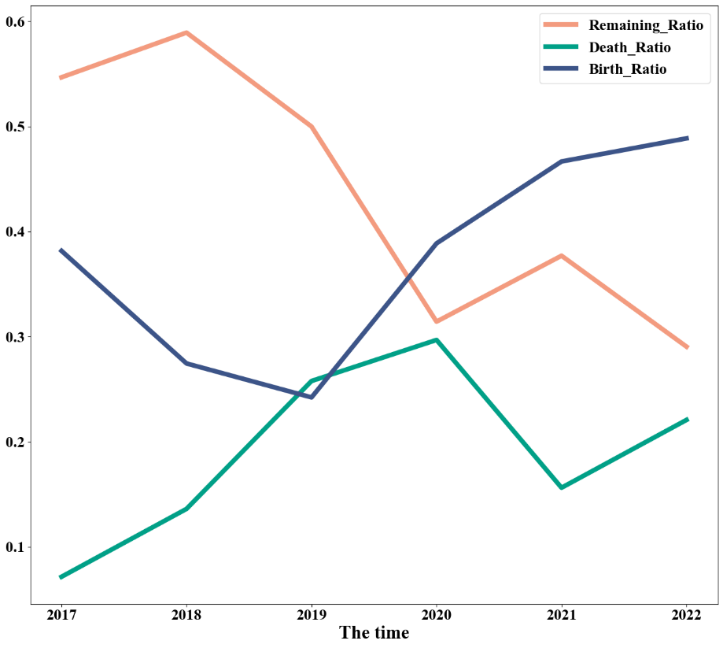
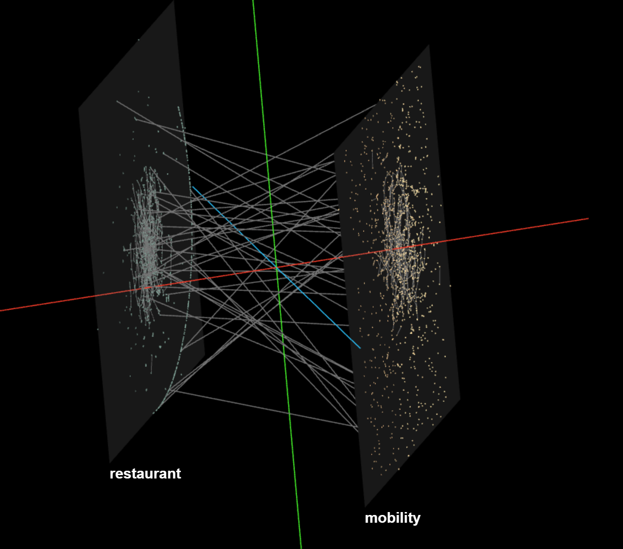
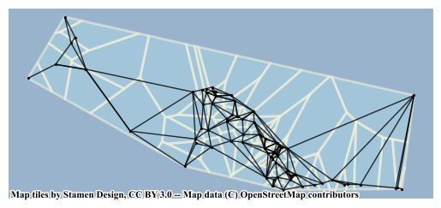
Background
Methods
Results
Conclusion
Future work
Research framework
✶
Grid internal network
Shenzhen restaurant closures to peak in 2020
A complex network of human mobility and restaurants

Slide 6
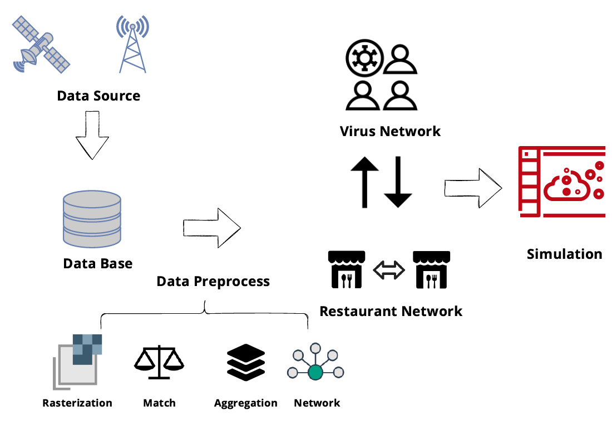
Background
Methods
Results
Conclusion
Future work
Data Source
Human Mobility Data (Mobile Phone Data)
Restaurant POI (Points of Interest)
Virus Transmission Survey
Figure: Data Processing Flow

Slide 7
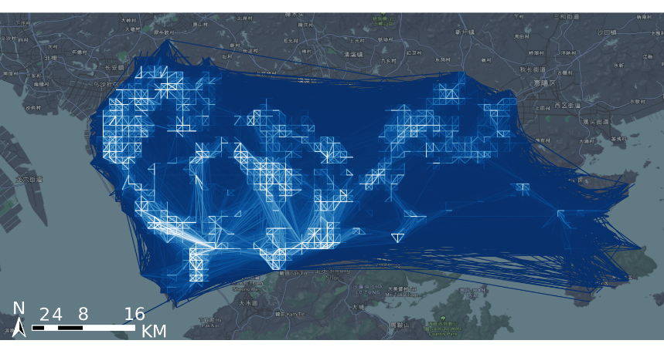
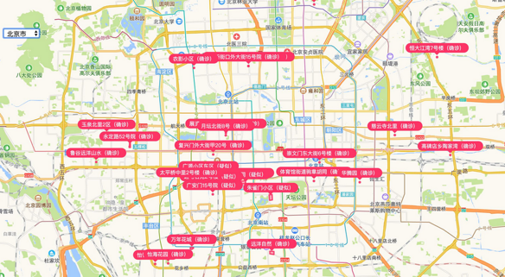
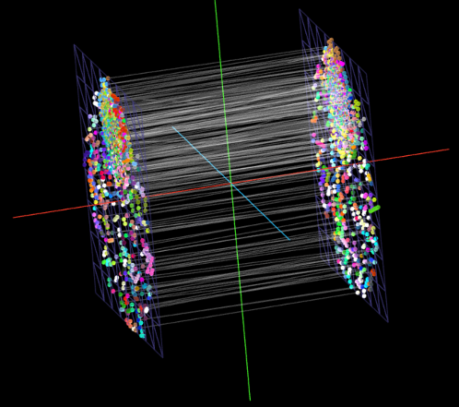
Background
Methods
Results
Conclusion
Future work
Complex multilayer network and node status settings
Human mobility network
virus transmission site
Restaurant proximity network
Multilayered nested network

Slide 8
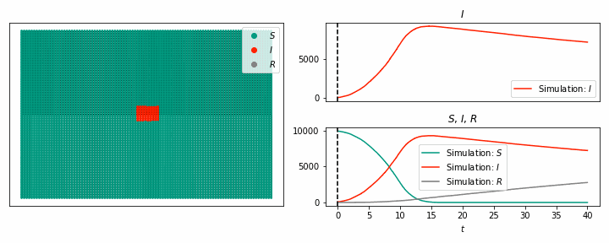
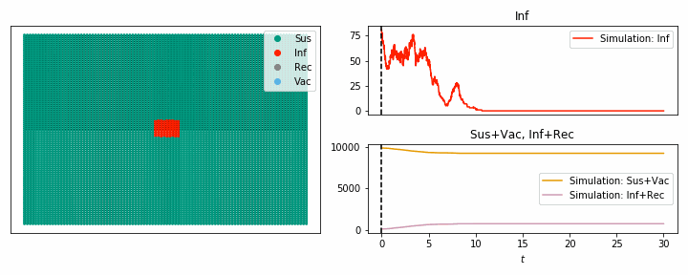
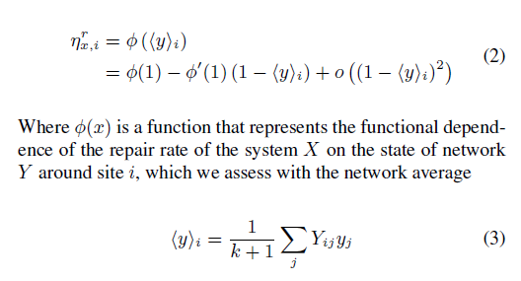
Background
Methods
Results
Conclusion
Future work
8
Percolation simulation
Percolation theory studies the connectivity and stability of complex networks, which can predict the phase transition phenomenon that occurs when the network is disturbed.
Example of percolation dynamics simulation，referenced from Kiss, Miller, and Simon's Mathematics of Cyber Epidemics (Springer, 2017)

Slide 9
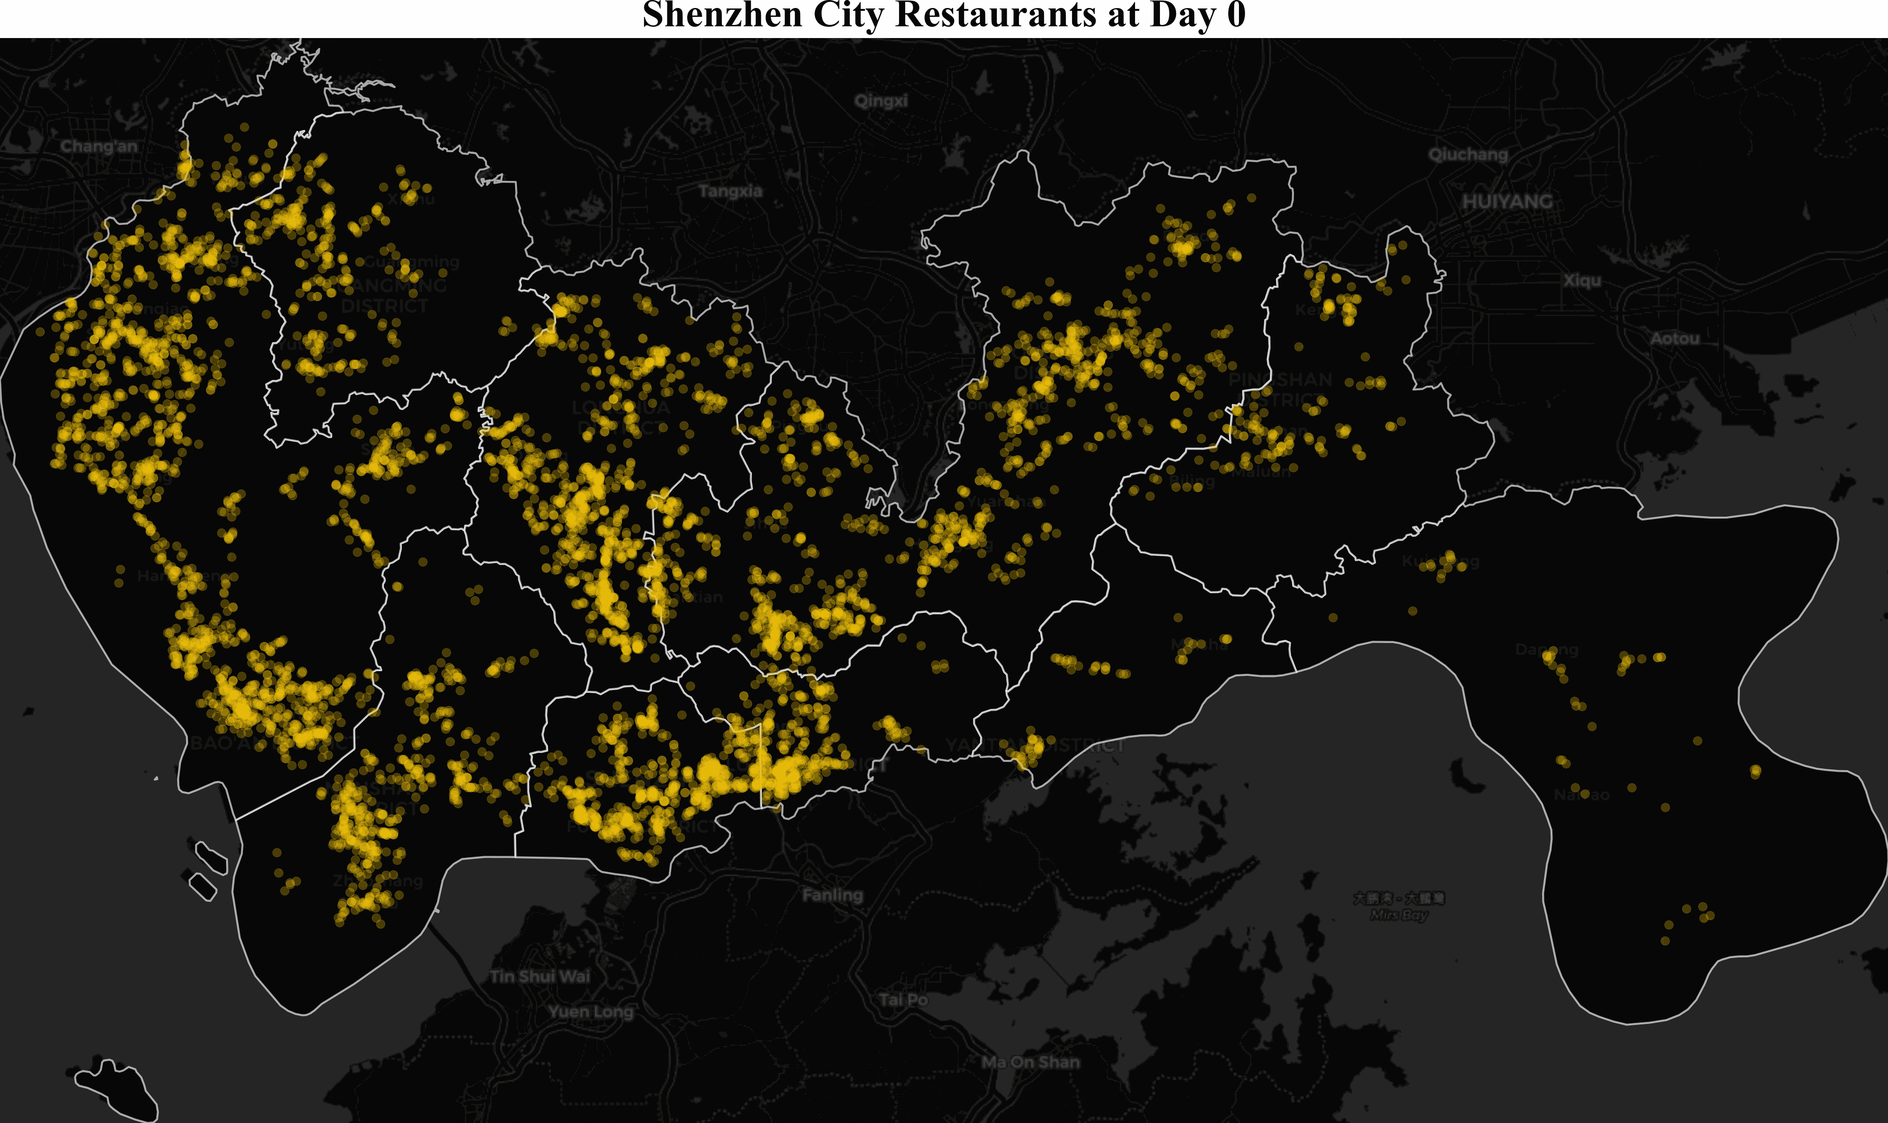
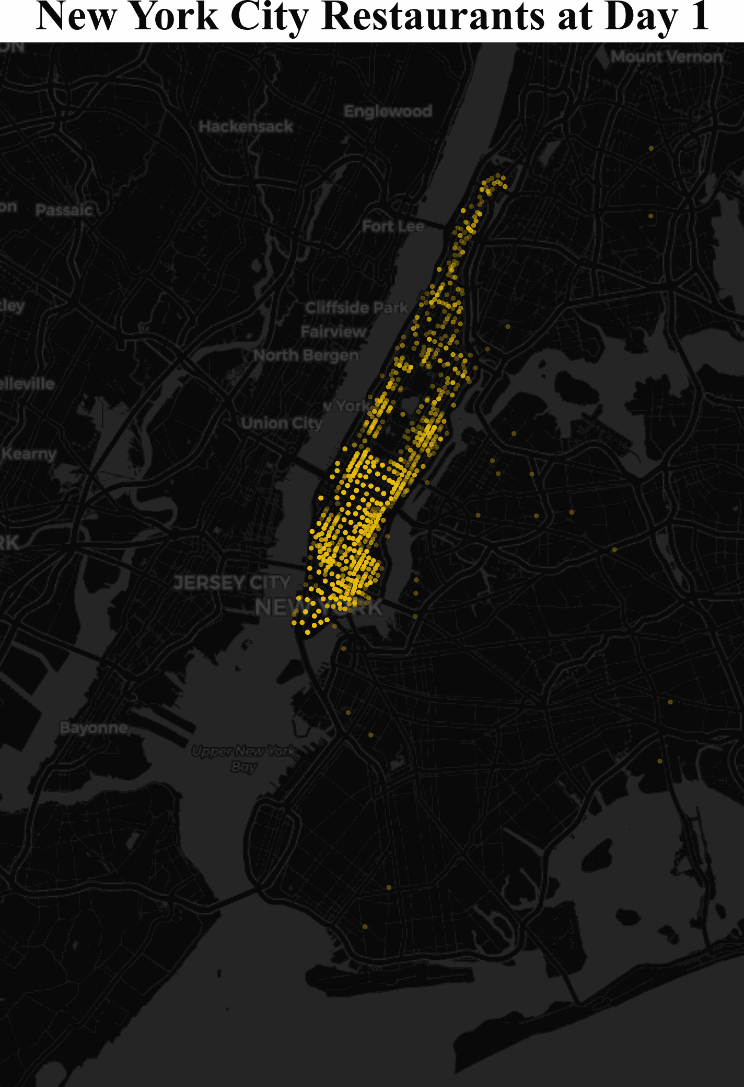
Background
Methods
Results
Conclusion
Future work
Spatio-temporal dynamics of urban economic resilience in Shenzhen and New York

Slide 10
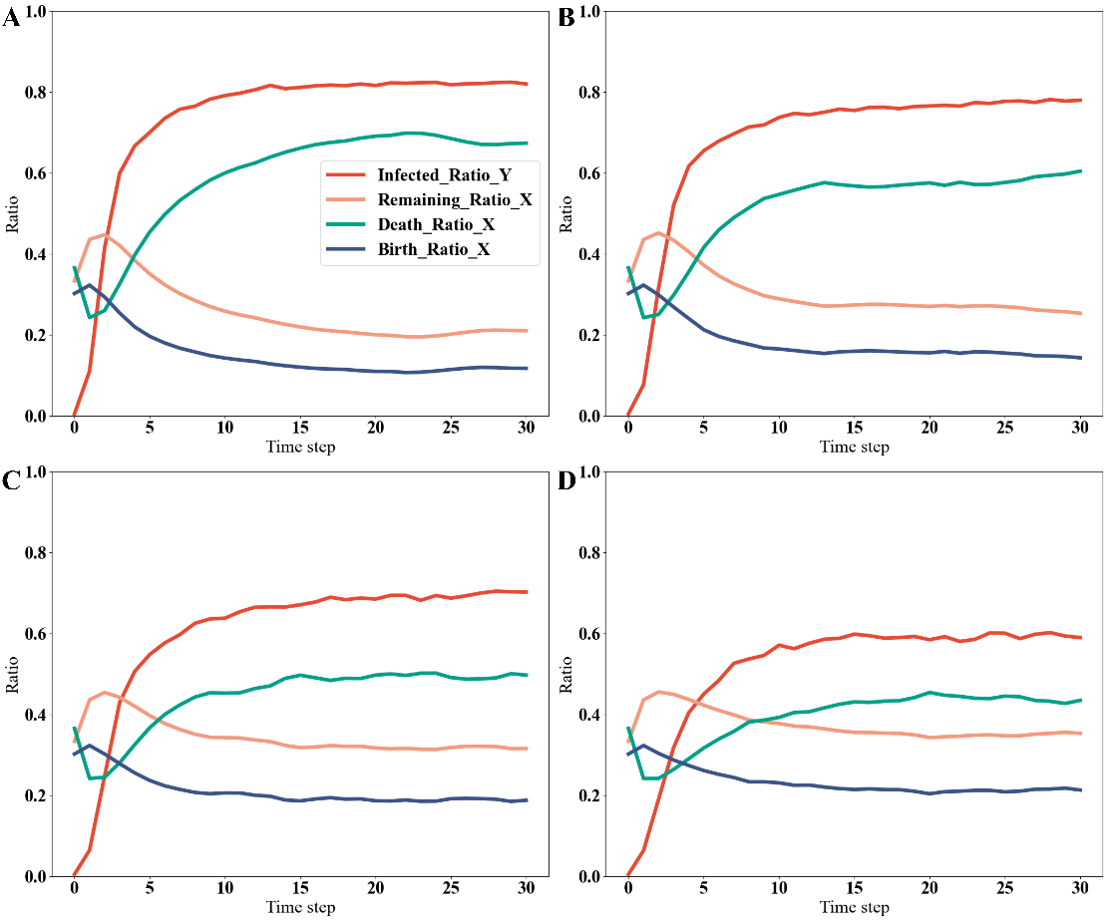
Background
Methods
Results
Conclusion
Future work
Effect of Lockdown on Disease Spreading Process and Economic Resilience
Remaining rate: the percentage of restaurants that endure.
Death rate: the fraction of restaurants that go bankrupt.
Birth rate: the percentage of new restaurants entering the market.
The $ε$-value represents the intensity of the intervention policy (lockdown).

Slide 11
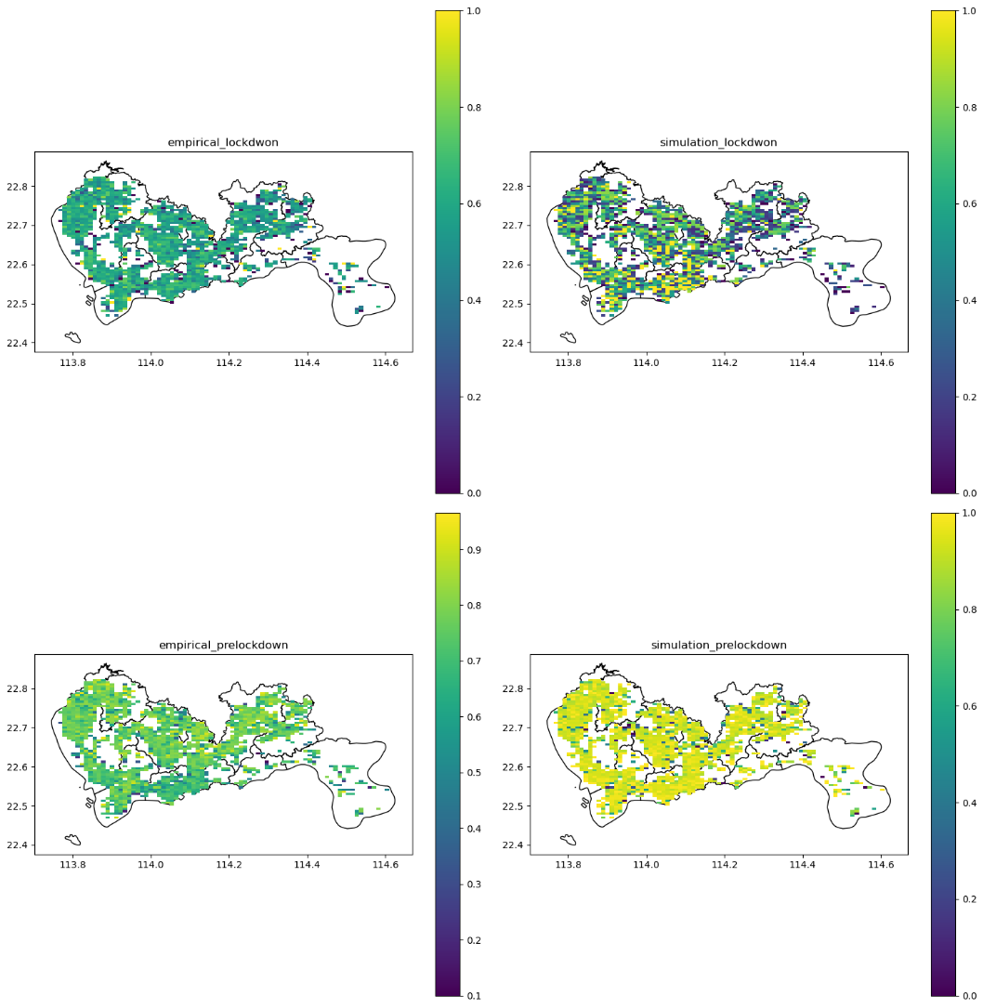
Background
Methods
Results
Conclusion
Future work
Spatial patterns of urban economic resilience
Empirical Lockdown
Simulation Lockdown
In terms of the spatial prediction ability, we compared the spatial distribution of the closed restaurants and obtained similar results to the empirical evidence
Empirical pre-lockdown
Simulation pre-lockdown

Slide 12
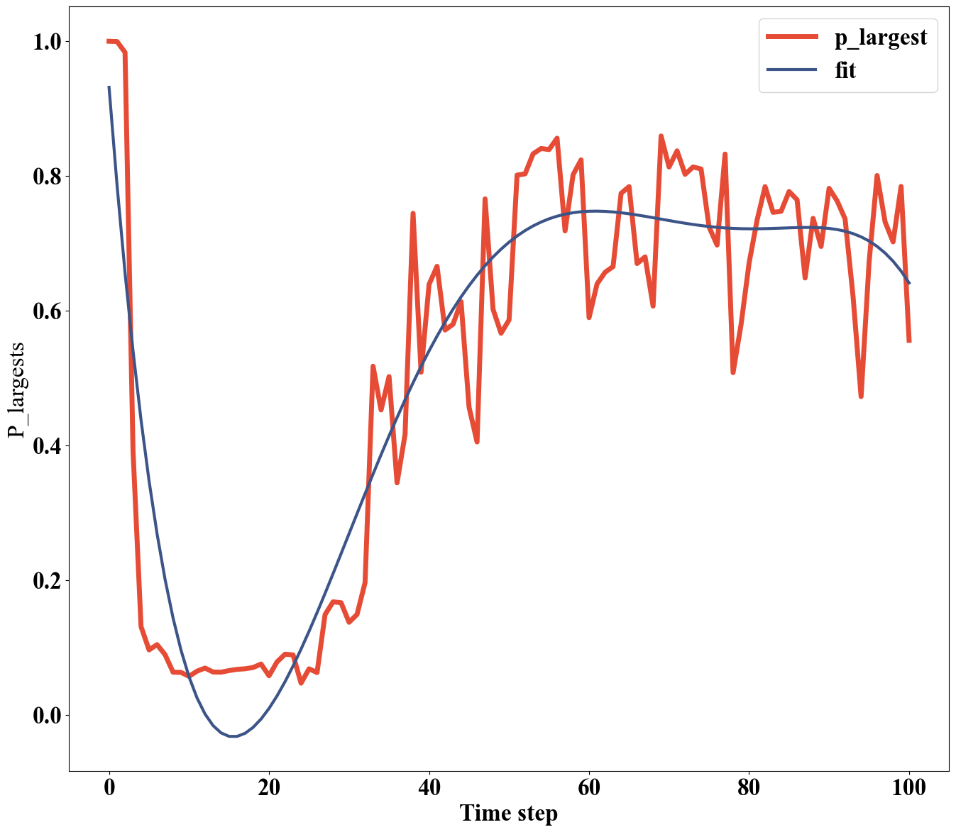
Background
Methods
Results
Conclusion
Future work
A Closer Examination of the Critical Transition: Infections and Economic Resilience

Slide 13
Background
Methods
Results
Conclusion
Future work
Human Mobility & Restaurants:
Utilized human mobility networks combined with the rise and fall of restaurants to evaluate urban economic resilience.
Dynamic Model:
Our model analyzes the spatiotemporal dynamics of urban economy under various pandemic states and government lockdown policies.
Implications for Planners & Policymakers:
Our research offers valuable insights for urban planners and policymakers in preparing for future pandemics or other disasters.

Slide 14
Background
Methods
Results
Conclusion
Future work
Conduct urban economic resilience analysis in different regions to validate the model's effectiveness (e.g., other cities in Asia and Europe).
Beyond pandemics, we hope this model can also be applied to other types of disasters (such as floods and earthquakes).

